Slide 1
DEMAND FORECASTING REGRESSION ANALYSIS

Slide 2
Content
What is forecasting all about?
Types of forecasting methods
Main Focus - REGRESSION ANALYSIS
Scatter Plot
Using OLS, Derive Regression Equations
Goodness of Fit: Regression Estimates?
Coefficient of Determination and Correlation
Standard error

Slide 3
“Prediction is very difficult,
especially if it's about the future.”
Nils Bohr
Prediction Vs Forecasting
Forecasting is a tool used for predicting future demand based on past demand information.

Slide 4
What is forecasting all about?
Demand for Mercedes E Class
We try to predict the future by looking back at the past
Predicted demand looking back six months
Time
Jan
Feb
Mar
Apr
May
Jun
Jul
Aug
Actual demand (past sales)
Predicted demand

Slide 5
Types of forecasting methods
Qualitative methods
Quantitative methods
Rely on subjective opinions from one or more experts.
Rely on data and analytical techniques.

Slide 6
Quantitative Forecasting Methods
Quantitative
Forecasting
Time Series
Associative Models
Models
Trend
Exponential
Moving
Linear
Projection
Smoothing
Average
Regression

Slide 7
REGRESSION ANALYSIS
Regression Techniques :
Y = a + bX
Referring to Gujarati & Porter (2010), Linear regression is based on
Fitting a straight line to data
Explaining the change in one variable through changes in other variables.
Independent
variable
Slope
i.e., marginal change
Dependent
variable
Vertical
intercept

Slide 8
Scatter Plot
This plot assess whether there is any association between two variables
Example: Advertisement Expenditure (Ads) Vs Sales Revenue (Sales)
Can you identify, which is the cause and which is the effect?
Assume, following table of Ads and Sales:
Year | Ads | Sales
1 | 10 | 93
2 | 9 | 85
3 | 11 | 109
4 | 12 | 132
5 | 13 | 145
6 | 14 | 158
7 | 15 | 169
8 | 17 | 220
9 | 19 | 205
10 | 20 | 245

Slide 9
Scatter Diagram
Sales Revenue
Year | Ads | Sales | Ads, Sales
1 | 10 | 93 | 10,93
2 | 9 | 85 | 9,85
3 | 11 | 109 | 11,109
4 | 12 | 132 | 12,132
5 | 13 | 145 | 13,145
6 | 14 | 158 | 14,158
7 | 15 | 169 | 15,169
8 | 17 | 220 | 17,220
9 | 19 | 205 | 19,205
10 | 20 | 245 | 20,245
Advertisement

Slide 10
Regression Analysis
It is the task of fitting a line through a scatter plot of cases that 'best fits' the data (Gujarati & Porter, 2010).
Called, Regression Line or A Line of Best Fit
Best Fit Line Means
choose values for regression parameters, by minimizing the sum of squared vertical deviations or residuals (et) between the actual values of the dependent variable and the fitted values (Pindyck & Rubinfeld, 2018)
Using Ordinary Least Squares (OLS) Criteria

Slide 11


Sales Revenue = 14.214 (Ads) - 42.9 R² = 0.9604
Sales Revenue
$$e_{i}$$
OLS Method
Yi
$$\hat{y_{i}}$$
Advertisement

Slide 12

Regression Equations
$${Sales}_{i}=a+b \left({Ads}_{i}\right)$$
Sales
Sum of Squares of Errors (SSE):
(Ads_{i},
Sales_{i})
Ads

Slide 13
Final Regression Equations
$${Sales}_{i}=a+b \left({Ads}_{i}\right)$$
Sales
(Ads_{i},
Sales_{i})
Ads
In General,

Slide 14
Example
Solve for a and b, using the following data:
Problem Statement: The weekly food demand are shown below. Fit a straight line and calculate average growth rate of food demand per week.
Week | Food Demand
1 | 59.5
2 | 66.7
3 | 74
4 | 80.2
5 | 86.4
6 | 93.1
7 | 100.2
8 | 109.5
9 | 117.2
10 | 122.4

Slide 15
Week (X) | Food Demand (Y) | X-Square | X*Y
1 | 59.5 | 1 | 59.5
2 | 66.7 | 4 | 133.4
3 | 74 | 9 | 222
4 | 80.2 | 16 | 320.8
5 | 86.4 | 25 | 432
6 | 93.1 | 36 | 558.6
7 | 100.2 | 49 | 701.4
8 | 109.5 | 64 | 876
9 | 117.2 | 81 | 1054.8
10 | 122.4 | 100 | 1224
Step 1: Calculate ∑
∑ 55 909.2 385 5582.5

Slide 16
Week (X) | Food Demand (Y) | X-Square | X*Y
1 | 59.5 | 1 | 59.5
2 | 66.7 | 4 | 133.4
3 | 74 | 9 | 222
4 | 80.2 | 16 | 320.8
5 | 86.4 | 25 | 432
6 | 93.1 | 36 | 558.6
7 | 100.2 | 49 | 701.4
8 | 109.5 | 64 | 876
9 | 117.2 | 81 | 1054.8
10 | 122.4 | 100 | 1224
Step 2: Get Final Equation
∑ 55 909.2 385 5582.5
Step 3 (final): Solve for a & b
a = 52.12 and b=7.05
Straight line is a + bx = 52.12 + 7.05x
Average growth of food per week is 7.05

Slide 17
Class Exercise
Fit a straight line and Solve for a and b, using the following data:
If P is the pull required to lift a load W by means of a pulley block, find a linear law of the form P = mW + c connecting P and W, using the data:
Pull | Load in Watts
12 | 50
15 | 70
21 | 100
25 | 120
32 | 154
40 | 170
50 | 190
Source: Collected from (Goyal, 2008)

Slide 18

Goodness of Fit: Regression Estimates?
Goodness of Regression Estimates is predicted based on Coefficient of Determination or (R²) value.
$R^{2}$- depicts the ‘percentage of the variation in the dependent variable that is accounted for by all the explanatory variables, measures the overall goodness-of-fit’ of the regression equation (Pindyck & Rubinfeld, 2018)
t
New thing: $\overline{Y}$ ??????

Slide 19
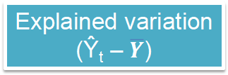

Determination of “Coefficient of Determination (R²)
Y
Y_{t}
Regression Line:
Ŷ = â + bX
.
ˆ
Total Variation
( Y_{t} – $\overline{Y}$ )
Unexplained variation
( Y_{t} – Ŷ_{t} )
Explained variation
(Ŷ_{t} – $\overline{Y}$)
Y
X
X_{t}

Slide 20
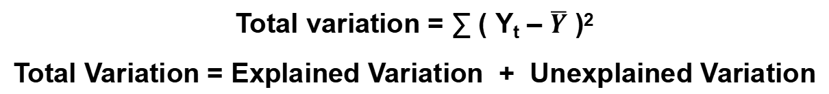
Determination of “Coefficient of Determination (R²)
Total variation = ∑ ( Y_{t} – $\overline{Y}$ )²
Total Variation = Explained Variation + Unexplained Variation
t

Slide 21
R² – Values?
The value of R² ranges from 0 to 1.
R² = 0 means that ‘independent variables explain none of the variation of the dependent variable’ (Pindyck & Rubinfeld, 2018)
R² = one means that ‘independent variables explain the variation perfectly’ (Pindyck & Rubinfeld, 2018)
In an Example of Sales and Ads, R² = 0.9604
Implies that Ads explains 96 per cent of the variation in Sales Revenue.

Slide 22
Coefficient of Correlation (r)

Slide 23
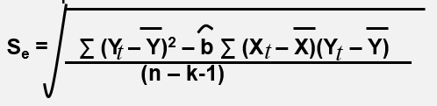
Prediction Using Regression Equations
With not cent percent accuracy, regression equation can be used to predict or estimate the value of independent variable.
Standard Error (Se) is a measure of probable error in the predicted values.
Lower the Se, better the fit of the data to the regression line, and better the prediction (Pindyck & Rubinfeld, 2018)

Slide 24
Class Exercise

Slide 25
A Sales Manager wants to know if there is a relationship between Price of a particular Metal and Demand for that Metal over different regions
Regions | Price (In Rs.) | Demand (Kgs)
1 | 630 | 15.5
2 | 370 | 7.5
3 | 616 | 13.9
4 | 700 | 18.7
5 | 430 | 8.2
6 | 568 | 13.2
7 | 1200 | 23.0
8 | 2976 | 87.3
Find the regression line equation ?
Interpret the slope.
Find and interpret Coefficient of Determination (R²

Slide 26
Regions | Price (X) | Demand (Y) | X^2 | X*Y
1 | 630 | 15.5 | 396900 | 9765
2 | 370 | 7.5 | 136900 | 2775
3 | 616 | 13.9 | 379456 | 8562.4
4 | 700 | 18.7 | 490000 | 13090
5 | 430 | 8.2 | 184900 | 3526
6 | 568 | 13.2 | 322624 | 7497.6
7 | 1200 | 23 | 1440000 | 27600
8 | 2976 | 87.3 | 8856576 | 259805
Sum | 7490 | 187.3 | 12207356 | 332621

Slide 27
Two equations :
187.3 = 8a +7490b and 332620.8 = 7490a + 12207356b
Multiplying first with 7490 and second with 8 will give us:
1402877 = 59920a + 56100100b and 2660966 = 59920a + 97658848b
b = 0.030273 and a = -4.930, Y = -4.930 + 0.0302X
Slope (b) = 0.030 means that for every increase of 1 Rs. In Price, Demand increases by 0.030 Kgs., on average.
r² = .982 means that there is a 98.2% reduction in error in predicting demand of metal by using price of that metal.

Slide 28
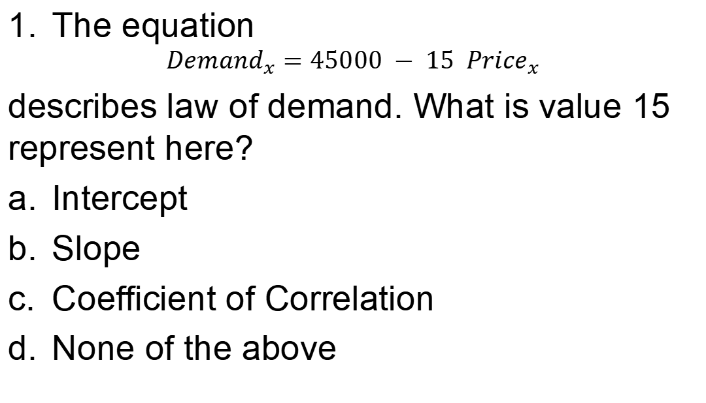
Review Questions
The equation
$${Demand}_{x}=45000 − 15 {Price}_{x}$$
describes law of demand. What is value 15 represent here?
Intercept
Slope
Coefficient of Correlation
None of the above

Slide 29
Review Questions contd.
2. The coefficient of determination is;
the square root of the correlation coefficient
usually less than zero
the correlation coefficient squared
equal to zero

Slide 30
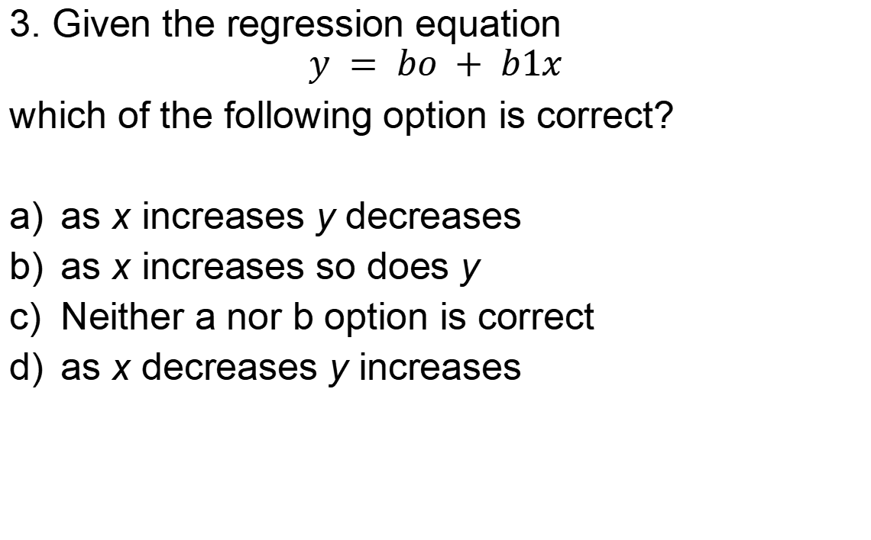
Review Questions contd.
3. Given the regression equation
$$y = bo + b1x$$
which of the following option is correct?
as x increases y decreases
as x increases so does y
Neither a nor b option is correct
as x decreases y increases

Slide 31
Review Questions contd.
4. Given the output of simple linear regression equation:
Sample size (n)= 15, Explained Variation=100, Total Variation = 152
Calculate the coefficient of determination?
a) 0.5200
b) 0.8111
c) 0.6579
d) 1.52

Slide 32
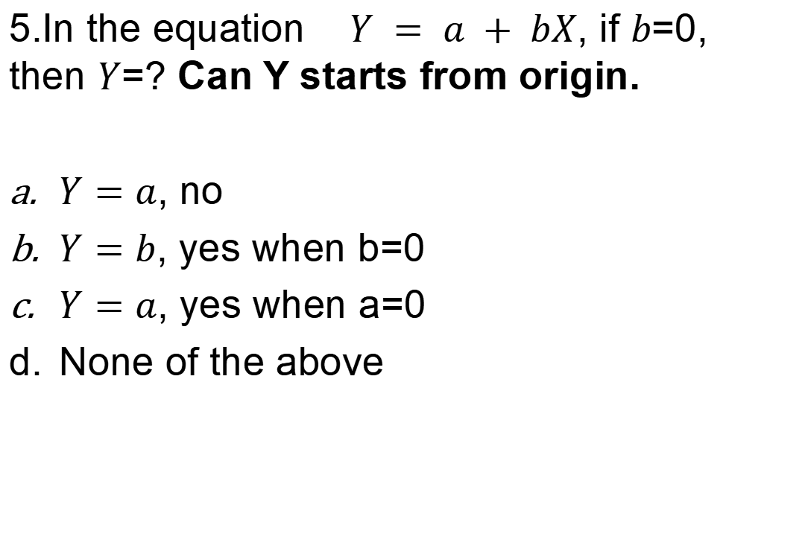
Review Questions contd.
5.In the equation $Y = a + bX$, if $b$=0, then $Y$=? Can Y starts from origin.
$Y=a$, no
$Y=b$, yes when b=0
$Y=a$, yes when a=0
None of the above

Slide 33
References
Gujarati, D. N., & Porter, D. C. (2010). Essential of Econometric (4th edition ed.). McGraw-Hill.
Pindyck, R. S., & Rubinfeld, D. l. (2018). Microeconomics. Pearson.
Robert, S. P., & Daniel, L. R. (1998). Econometric models and economic forecasts. New York, NY: Irwin and McGraw-Hill.
Goyal, M. (2008). Computer based numerical & statistical techniques: INFINITY SCIENCE P RESS LLC.

